Slide 1


Open House

Slide 2
Don’t Forget…
Make sure you signed the sign-in sheet or signed in using the digital form (QR Code)
A copy of the 3rd Grade Syllabus will come home Tuesday
Leave supplies at your child’s desk

Slide 3
Administration
Principal – Ms. Crystal Middleton (Middlcr@boe.Richmond.k12.ga.us)
Assistant Principal – Ms. Amanda Darville (Darviam@boe.Richmond.k12.ga.us)
Assistant Principal – Ms. Wendy May (Maywe@boe.Richmond.k12.ga.us)

Slide 4
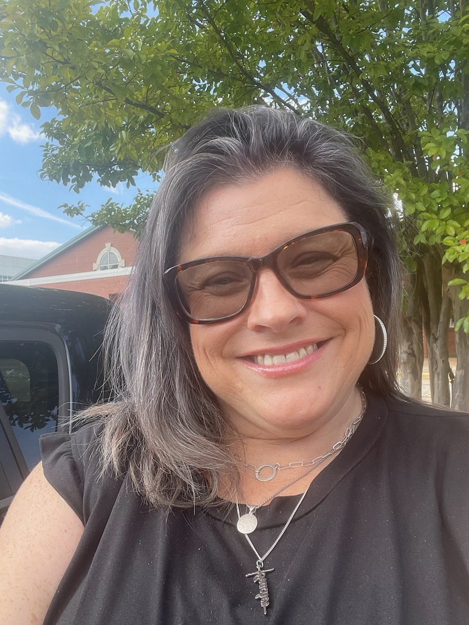
Email Address: beardme@boe.Richmond.k12.ga.us
Melissa Renee Beard
Room 305
Teaches Science, Social Studies, & Health
She is from Rome, Ga and she loves history. Her favorite historical item is the USA flag.
Email Address: beardme@boe.richmond.k12.ga.us

Slide 5

Email Address: beardme@boe.Richmond.k12.ga.us
Tia Burton
Room 307
Teaches English Language Arts
She loves spending time with her family, reading inspirational books, watching movies, and solving puzzles.
Email Address: burtoti@boe.richmond.k12.ga.us

Slide 6
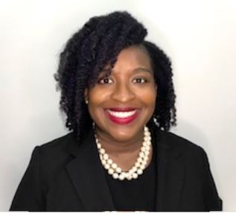
Email Address: beardme@boe.Richmond.k12.ga.us
Stephanie Garrett
Room 308
Teaches Mathematics
She loves listening to audiobooks & podcast, traveling and being a mommy.
Email Address:
scottst@boe.richmond.k12.ga.us

Slide 7
First Day of School
Tuesday, August 5, 2025
Students may enter the building at 6:50am – Please do not drop students off before that time.
Start Time: 7:25 a.m. (tardy bell)
Dismissal: 2:15 p.m.
How will your child get home? Please indicate this to your child’s homeroom teacher!

Slide 8
Building Protocol
Per FPS protocol, parents are NOT allowed to come down the hallways.
All parent-teacher meetings need to be scheduled ahead of time. You can contact teachers any time via ClassDojo.
There will be staff members at the front of the school and placed throughout the building to help students get to their classrooms and carry supplies.
Supplies can be brought in the rest of this week if you want to drop them off before school starts.

Slide 9
Transportation
Be sure to indicate how your child will get home the first day of school
Dismissal is at 2:15 p.m.
Dismissal Locations:
Bus: Front of school
Car Rider: Back side of school (across from soccer fields)
Parent Pick-up and CYS: Big Gym
Big Brother/Big Sister Walker: Art Room (Older sibling MUST be in 8th grade for this option)
If afternoon transportation changes, you MUST let ALL teachers know with a written note/message AND ClassDojo before lunchtime. *Be sure you receive back a response to ensure we have received your message!!*

Slide 10
Daily Schedule
Time | Min. | Period |  | Beard SC/SS/HTH | S. Garrett Math | Burton ELA
7:25-7:30 | 5 | Homeroom
7:30-8:00 | 30 | Intervention |  | (ELA) | (Math) | (ELA)
8:00-9:15 | 75 | 1st Period |  | Burton HR | Beard HR | Garrett HR
9:15-10:05 | 50 | Connections
10:05-10:15 | 10 | 1st Period (continued) |  | Burton HR | Beard HR | Garrett HR
10:15-11:20 | 65 | 2nd Period |  | Garrett HR | Burton HR | Beard HR
11:20-11:55 | 30 | Lunch & Transition |  | Garrett HR 11:20 a.m. | Burton HR 11:25 a.m. | Beard HR 11:23 a.m.
11:55–12:10 | 15 | Recess
12:10-12:30 | 20 | Finish 2nd Period |  | Garrett HR | Burton HR | Beard HR
12:30-1:50 | 80 | 3rd Period |  | Beard HR | Garrett HR | Burton HR
1:50-2:00 | 10 | SEL
2:00-2:10 | 10 | Dismissal/Clean up

Slide 11
Email Address: beardme@boe.Richmond.k12.ga.us
Attendance Policy
Students are expected to be in school all day unless they are ill.
Georgia State law only recognizes absences due to illness, religious holidays, medical or legal appointments, and funerals in the family. Parents have the right to present reasons they believe are justifiable to the Principal for consideration of other absences.
All absences require a written note from parents/guardians stating the reason for the absence. The note must include the student's full name, reason for absence, date(s) of absence, and parent/guardian signature. Emailed notes will not be accepted. A note without a reason and date of absence is unexcused.
Parents have 5 ‘parent excused’ absences per school year. After 5, then there must be a doctor’s note or other type of document for the absence to excused.
In order to comply with district regulations and state law, when a student has 10 unexcused absences in one month or ten unexcused absences in one year, Richmond County administrators will petition the Juvenile Court System to seek mandatory attendance by a student.

Slide 12
Email Address: beardme@boe.Richmond.k12.ga.us
Attendance Policy
An unexcused absence is defined as any unauthorized absence from school. Examples include, but are not limited to:
1. Hair appointments
2. Oversleeping
3. Shopping
4. Missing the bus
5. Concerts
6. Babysitting
7. Failure to obtain private transportation to school
8. Mechanical problems
9. Failure to obtain leave of Absence request for absences

Slide 13
Email Address: beardme@boe.Richmond.k12.ga.us
Tardy Policy
Students are not allowed on campus prior to 6:50 a.m. All students should report to school by 7:25a.m (tardy bell rings). Any student reporting to the classroom after 7:25 a.m. is tardy. A parent must sign in tardy students in the front office.
The accumulation of unexcused tardies may warrant disciplinary action and/or referral to Department of Family and Children Services.
Leaving school for unauthorized purposes before the end of the instructional day will be counted as a tardy. Parents should not pick their children up before the end of the school day except where there is a legitimate emergency. Lawful excuses for tardiness are cited in the RCSS Code of Student Conduct and Discipline. For the safety of our students during dismissal transition, we will not allow building entry starting at 1:55 pm until 2:10pm.
More information regarding attendance is located in the RCSS Code of Student Conduct and Discipline.

Slide 14
Email Address: beardme@boe.Richmond.k12.ga.us
Bullying Policy
At FPS we strive to maintain a respectful environment for staff and students.
Bullying behavior is defined as any pattern of written or verbal expression or any physical act or gesture that is intended to ridicule, humiliate, intimidate, or cause measurable physical or emotional distress upon one or more students.
A student shall not do, attempt, or threaten to bully any person, including students and employees:
a) In the school
b) On school grounds
c) In school vehicles (including school buses)
d) At school bus stops
e) Or at school activities or sanctioned events
https://www.rcboe.org/domain/7821 (Bullying Form for Parents)

Slide 15
Email Address: beardme@boe.Richmond.k12.ga.us
Bullying Policy
Bullying behavior is defined as any pattern of written or verbal expression or any physical act or gesture that is intended to ridicule, humiliate, intimidate, or cause measurable physical or emotional distress upon one or more students.
A student shall not do, attempt, or threaten to bully any person, including students and employees:
a) In the school
b) On school grounds
c) In school vehicles (including school buses)
d) At school bus stops
e) Or at school activities or sanctioned events
A third instance of bullying in a school year would require that the student be assigned to an alternative educational setting. However, the principal or other appropriate designee may recommend the Alternative Center or suspension, in her discretion prior to the third offense.
*FOR PRE-K – 5 REFER TO RULES 23 AND 24 (RCBOE CODE OF CONDUCT)
*FOR 6 -12 DISCIPLINE OPTIONS, REFER TO RULES 23, 24, &amp;27 (RCBOE CODE OF CONDUCT)
Code of Discipline for Freedom Park School: Students are expected to display admirable Character Traits at all times. They are representative of their family, school and community. At FPS we have always maintained a respectful environment for staff and students.
If you suspect that your child is being bullied, you can fill out this Bullying Reporting Form from RCSS: https://www.rcboe.org/domain/7821

Slide 16
Behavior Management
Students are expected to come to school ready and prepared to learn.
Each class has expectations that students are respectful, responsible, and safe.
3rd grade standards that assess behavior:
3BL1 Follows oral and written directions, 3BL2 Works independently, 3BL3 Work cooperatively, 3BL4 Participates in class, 3BL5 Completes classwork, 3BL6 Completes homework, 3BL7 Produces best work, 3BL8 Demonstrates self-control
You will be informed if your child has any behavioral concerns.
Please read the syllabus that includes the Behavior Management Plan with your child. We will send a form via ClassDojo at later date for you to sign stating you’ve read this document.

Slide 17

School Nutrition
Breakfast starts and 6:50 am and is free for all students. Breakfast ends at 7:20
Lunch IS FREE for ALL students. However, your child is still allowed to bring lunch from home to eat in the school cafeteria.
3rd Grade Lunch Time: 11:10am
Students can bring a snack to have during recess or at dismissal time.

Slide 18
Elementary
School Counselor
What does an Elementary School Guidance Counselor do?
Whole Group Classroom Lessons
-Teach students as a class on lessons regarding bullying, character education, coping with loss, stress/anxiety, and peer pressure
Individual Counseling Sessions
-Assist students individually with loss, peer pressure, anxiety, and bullying
Group Counseling Sessions
-Group sessions held with 6-8 students on topics such as coping with anger, dealing with peer pressure, social skill development, and coping with loss
Crisis Counseling Sessions
-Sessions held to assist students with immediate needs that must be addressed by the counselor

Slide 19
Cellphone & Electronics Policy
Electronic Devices
What about emergencies?
Cellphones, electronic devices, or accessories must be turned completely off AND put away out of view at all times while at school.
No text messaging, application-based communication, or social media use is allowed at school.
Please contact teachers via dojo AND the front office for any emergencies that arise during the day.
*If the teacher does not respond back via dojo, please be sure to call the school to have them give us the message!

Slide 20
Title I
Freedom Park School is a Title I school. This means we are provided financial assistance through the Every Student Succeeds Act, Part A.
Its overall purpose is to ensure that all students have a fair and equal opportunity to obtain a high-quality education and reach, at a minimum, proficiency on state assessments (i.e. GA Milestones, End-of-Course, etc.), as well as involve parents in their child's education.
There will be an upcoming Title I Annual Parent Meeting which will outline parent involvement opportunities - you will be sent meeting information via FPS's ClassDojo account later in the school year.

Slide 21
Infinite Campus Parent Portal
Infinite Campus is the platform Richmond County uses for student grades
Parents can access and view their child’s grades and get alerts when grades have been entered.
Parent Portal Sign-Up Directions – Click HERE
Parent Portal Sign-Up and troubleshooting on RC site – Click HERE
Sign-up today using one of the laptops in Ms. Beard’s room (Rm. 305)
You MUST have your child’s Social Security number in order to sign-up.

Slide 22
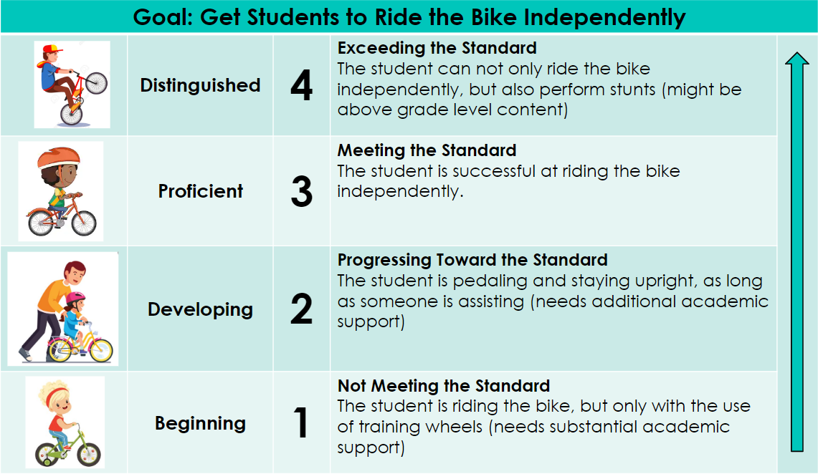
Burton
HR
Hastings
HR
Sergio HR
Beard
HR
Grading
In the RCSS, 3rd grade uses Standards Based Grading. Students are graded on a scale of 1-4
Some standards have multiple parts to them. For these standards, students will not be able to score a 3 or 4 until the entire standard has been taught. You will see this on your child’s graded papers (score might say 2/2 meaning the highest score could only be a 2)
Students cannot receive a score of 4 until they consistently show mastery of that standard with zero teacher support over an extended period of time.
Graded papers will be sent home periodically
RCSS Standards Based Grading Guides for Parents: https://www.rcboe.org/Page/46988

Slide 23
What will my child learn?
See the Third Grade Syllabus
ELA (Writing): (Style and Structure) Writing genres to include Narrative, Informational, and Opinion/Argumentative as well as figurative language, grammar, usage, and mechanics (GUM)
ELA (Reading): Phonics/Fundations, context (text features, describing different perspectives, interpreting text , general, academic & specialized vocabulary, etc.
Math: place value, multiplication, division, geometry, algebra, how to answer and respond mathematically (C.U.B.E.S), etc.
Social Studies: Native Americans, explorers, government, etc.
Science: fossils, pollution, heat energy, etc.
Health: Disease prevention, healthy habits, etc.

Slide 24
Student Responsibilities
We will support your child with the following responsibilities:
Plan appropriately and learn to balance the increased workload in order to successfully complete all class work and all homework.
Using Classlink/Launchpad to access Canvas (online work platform) and other websites for class.
Participate fully in class, to include discussions online and uploading of assignments to Canvas, as well as asking questions for better understanding.
Maintain proper behavior at school and while participating online.
Respect self and others.
Maintain the M.O.O.S.E. Notebook and its contents (homework, calendar, divided sections of notes, etc.)

Slide 25
Communication
Sending a message via ClassDojo is the BEST way to communicate with your child’s teachers.
You may also email us or send in a note
Conferences
Infinite Campus Parent Portal (view grades)
Weekly Newsletter sent out via ClassDojo

Slide 26
Student Laptops
Each student will be assigned a laptop to use in the classroom later this month.
Students will have the option, with parent permission, to take their laptop home each day.
Room 305 (Ms. Beard) you can go ahead and sign this permission form if you desire your child to bring home the laptop.
*Please note that it is the expectation of child to return the laptop charged and ready to use EACH school day!

Slide 27
Thank you for coming!
We appreciate your support!
Make sure you signed the sign-in sheet or signed in using the digital form (QR Code).
Say hello to your child’s other teachers.
Room 305 (Ms. Beard) has student laptop forms you can sign for permission to take them home
Room 310 (Ms. Garrett) Sign-up for the Parent Portal
Transportation (bus numbers) etc. – Go to the cafeteria or gym to receive information
Click to set up an Infinite Campus Parent Portal Account to see grades
https://www.rcboe.org/cms/lib/GA01903614/Centricity/Domain/213/IC%20Parent%20Portal%20Instructions.pdf
Questions?

